Slide 1
BEST PRACTICES KERALA
PRADHAN MANTHRI KRISHI SINCHAYEE YOJANA –
WATERSHED DEVELOPMENT COMPONENT

Slide 2
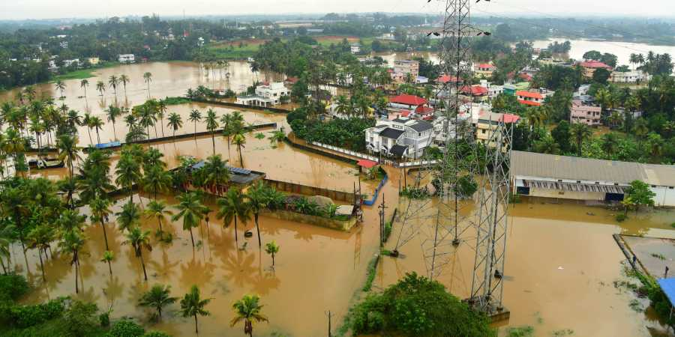
Survival of 2018-19 Floods through PMKSY(WDC)
ALAPPUZHA

Slide 3
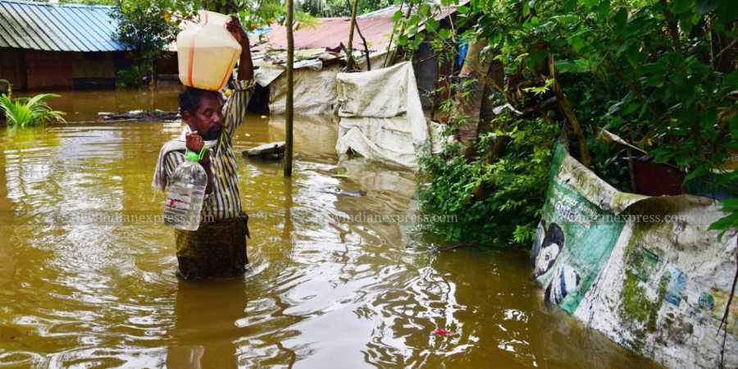
2018 flood impacts
Alappuzha – worst affected during 2018-19 floods.
Mavelikkara - Kuttanad and upper Kuttanad area was severely affected .
Drinking water sources were polluted.
Severe Damage to paddy fields.

Slide 4
ENSURE QUALITY DRINKING WATER
Name of project : IWMP-IV/2013-14
Name of PIA : Mavelikkara Block Panchayat
Name of Grama
Panchayats : (4) Chennithala, Mannar, Pallippadu,
Veeyapuram
Micro Watersheds : (2) Kakkad, Thripperuthura

Slide 5
Implementing Strategies
After flood, PIA has decided to test the drinking water quality of the wells in the project area
3
Availed 40 kits from CCDU, Water Resource Department, Kerala
1
Trained 63 Asha workers, CDS, ADS members
Tested water samples from 4000 families in the project area
4
2

Slide 6
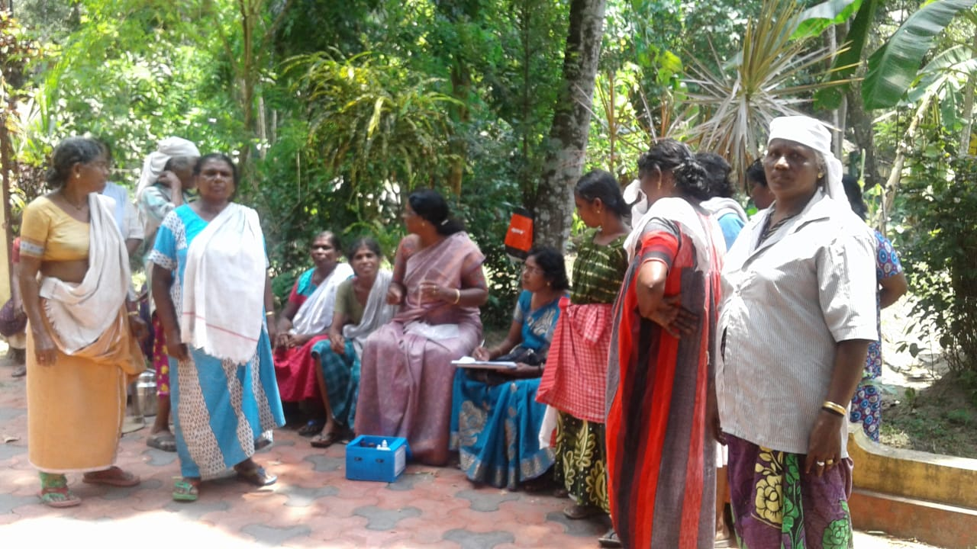
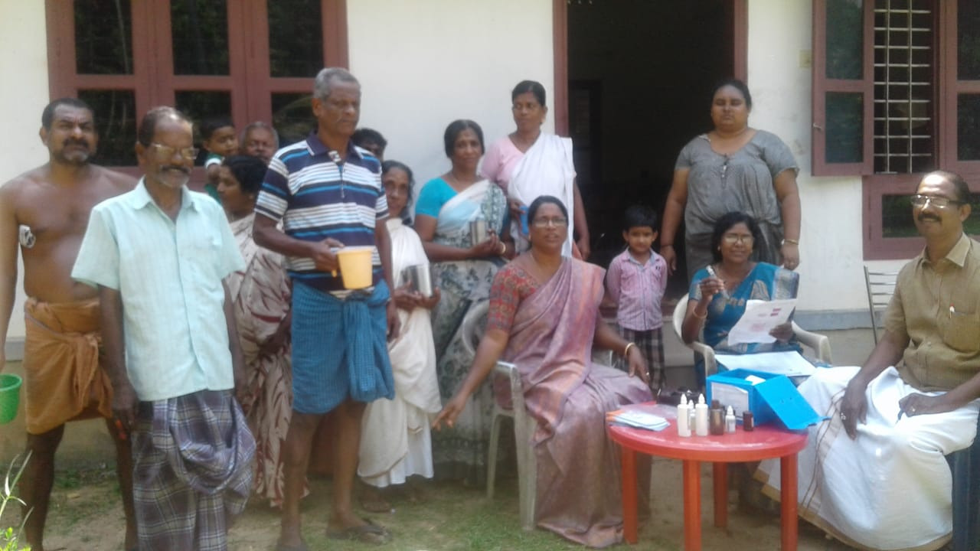

Slide 7
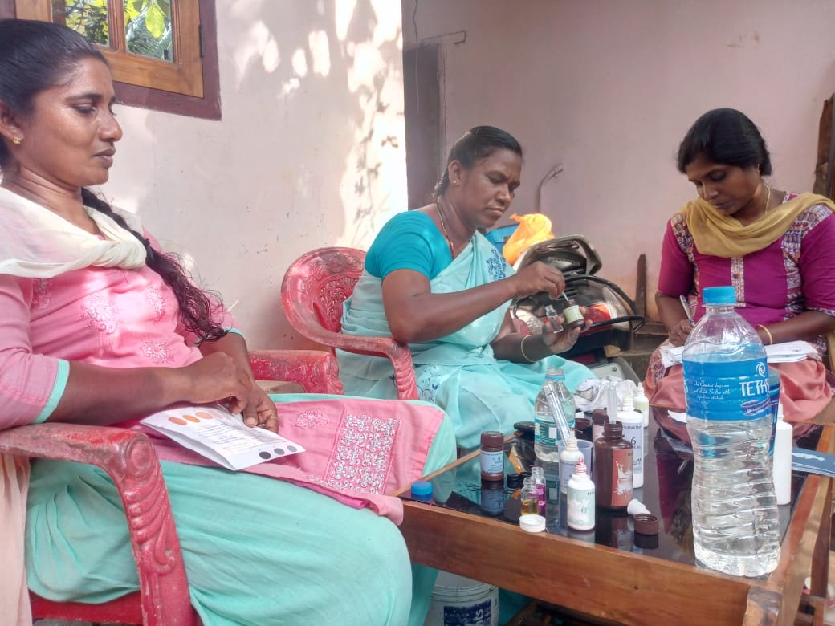
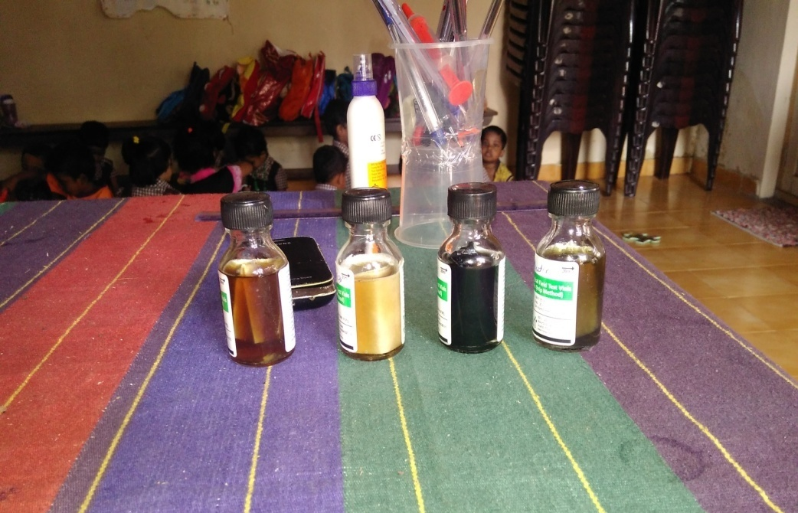
Result was send to CCDU for analysis
5
Found out the presence of e coli bacteria in all samples
2112 Samples were listed under contaminated water –unsafe to drink
Presence of Chloride, Flouride, Total Coliform, Iron contaminants

Slide 8
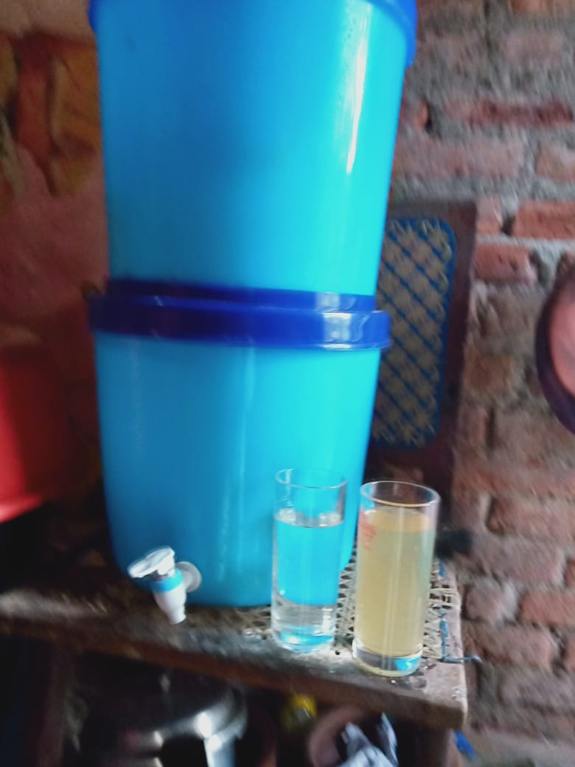
6
Identified 1300 families from the list
Availed Terafil water filter from CIPET, Bhuvaneswar
Hands on training to beneficiaries
Huge relief to the affected families
Expenditure under PMKSY – 9.33167
Unit cost – 720/-

Slide 9
Strengthening Outer Bund with Coir Geotextiles at Kudavellari B Padasekharam
Name of Grama Panchayat : Mannar
Name of Watershed : Thriperumthura watershed
Convergence With Mahatma Gandi NREGS

Slide 10
Implementing Strategies
100 ha of paddy fields spread along the Kuttamperoor aaru was flooded and destroyed during the 2018 floods
3
Strengthening of 1000m long bund was taken as two reaches in convergence with MGNREGS
1
Bund strenthening under MGNREGS & Geotextiles and bamboo stakes was provided from PMKSY (WDC)
The field and cultivation survived during 2019 flood
4
2
The padasekhara samiti had to construct bund around the fields frequently
Mandays -1826
Expenditure – 494846 (MGNREGS), 469725 (PMKSY)

Slide 11
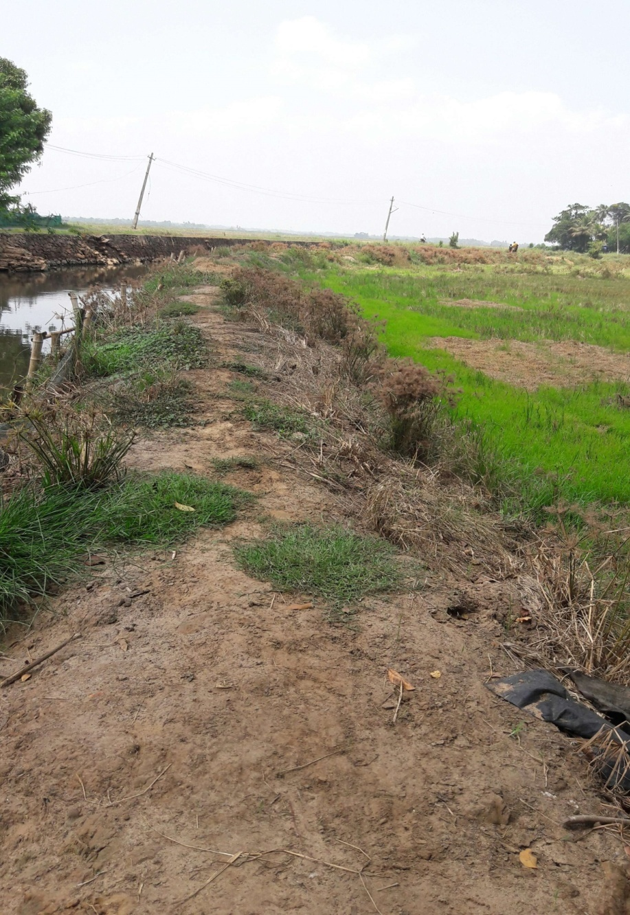
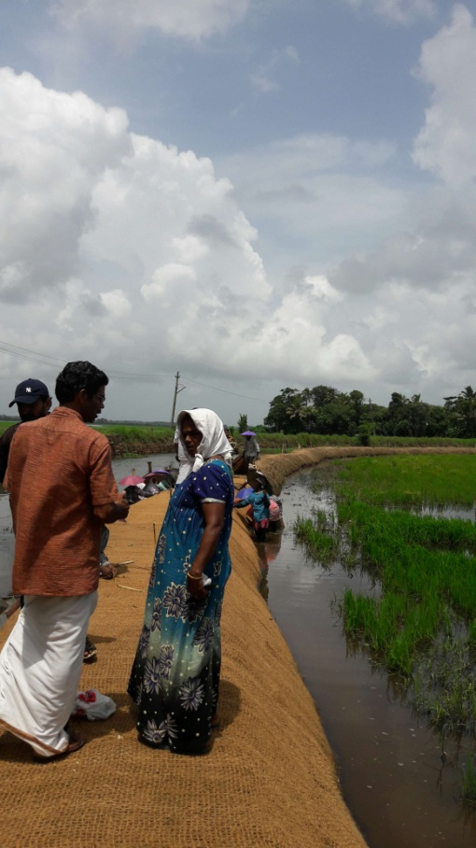

Slide 12
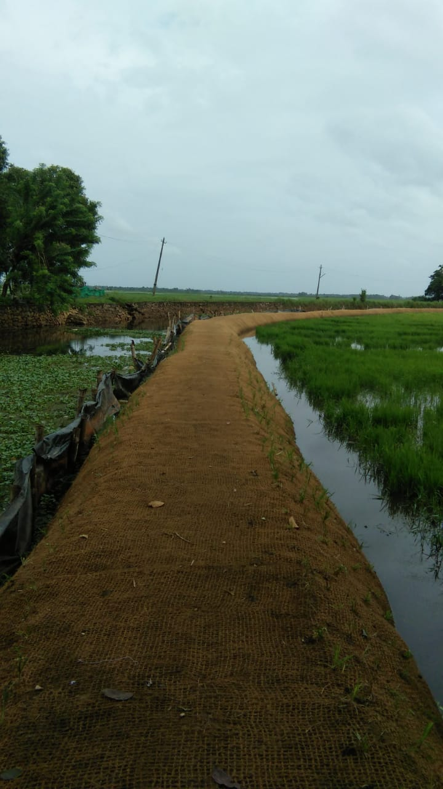

Slide 13
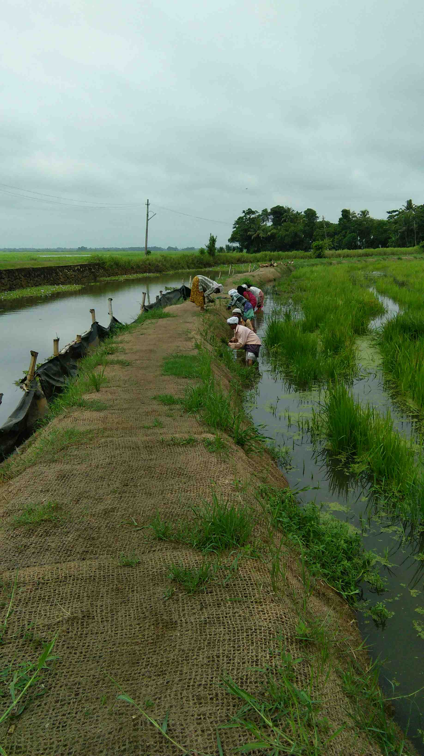

Slide 14
BEST PRACTICE IDUKKI DISTRICT

Slide 15
Idukki one of the worst affected district during the last two floods.
Land slide is the major threat.
All watershed interventions are not possible due to the peculiar physiographic nature of the area.
Subsurface storage of rain water has little scope.
Natural drains have to be stabilised to prevent formation of ravines.

Slide 16
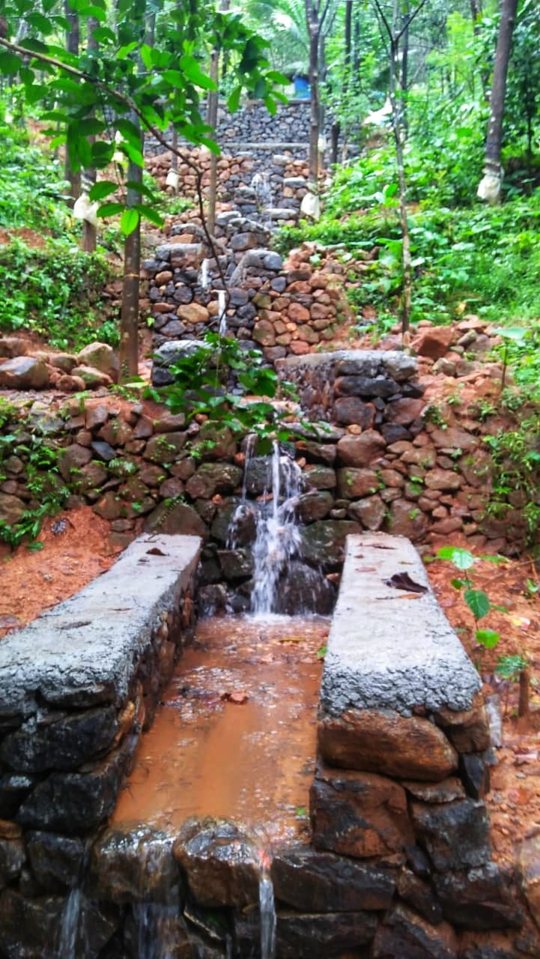
STREAM STABILISATION AT UPPUKULAM WATERSHED
Batch III- IWMP IV/2011-12 Azhutha Block
Name of Watershed: Uppukulam Watershed
Panchayat: Kokkayar
Name of work: Stream stabilisation
Estimate amount: 2.4 lakhs
Constructed material: DR Masonry, PCC

Slide 17
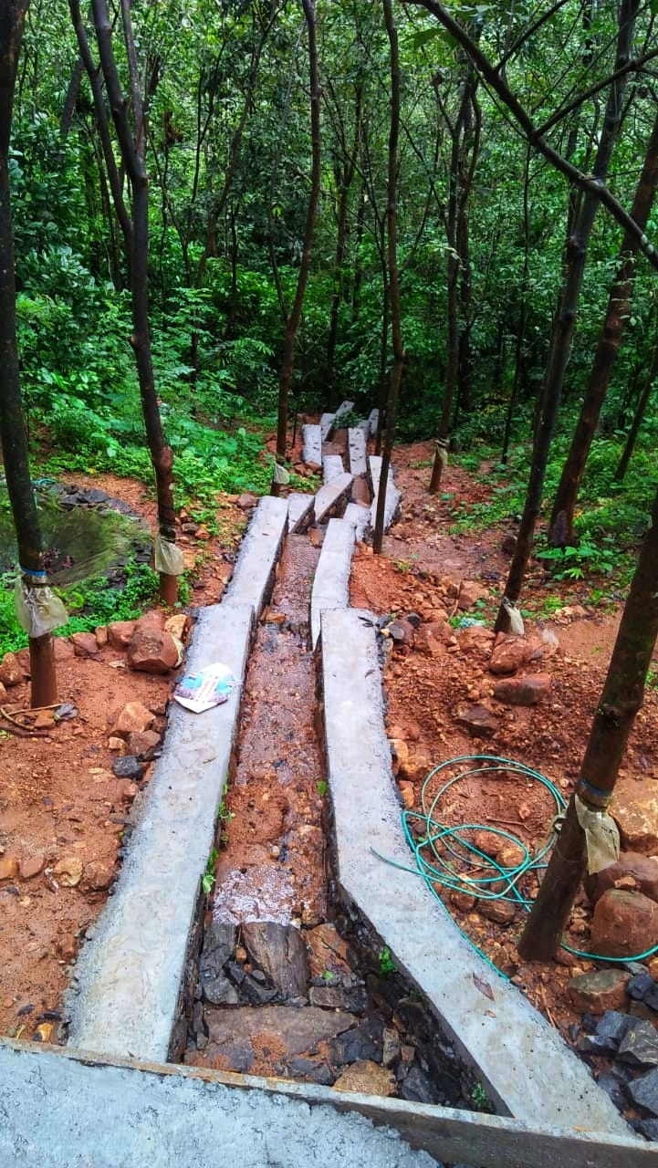
Uppukulam watershed belongs to Azhutha block Panchayat has been suffered a lot from soil erosion issues. Uppukulam stream stabilization is adequate to prevent further deterioration of the watershed. Estimating an amount of Rs. 2.4 lakhs expenditure, User group has implemented the work.

Slide 18
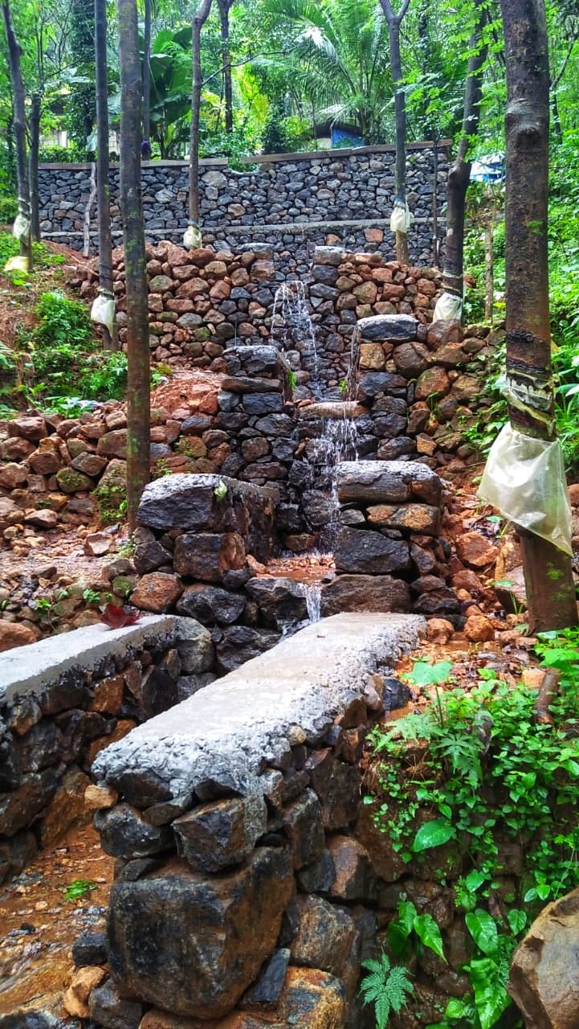
By constructing the bund it reduces the intensity flow of water using step-end method. It reduces soil erosion, enhances the moisture content of surrounding areas and thereby enhances production. This is one of the best practises suited for land slide prone areas.

Slide 19
INNOVATIVE IDEA
‘Athijeevanam Mulayiloode’ campaign-survival using bamboo.
In order to reduce the intensity of floods and resultant landslide, it has been decided to plant bamboo in land slide prone areas.
It decided to be done in a campaign mode under the auspicious of PMKSY-WDC in convergence with MGNREGA, School children, youths, recreation clubs etc under the technical guidance of Kerala Forest Research Institute.

Slide 20
It can be planted in all areas under class VII and VIII to prevent land degradation.
It has got the advantage of no soil piping effect due to the fibrous root system.
It has got diversified uses which provide livelihood option to a section of the community.

Slide 21
Thank you

